Slide 1
An Introduction to Parallel Programming
Peter Pacheco
Chapter 3
Distributed Memory Programming with
MPI
Lecture 7
Copyright © 2010, Elsevier Inc. All rights Reserved
Notes:
The University of Adelaide, School of Computer Science
Chapter 2 — Instructions: Language of the Computer

Slide 2
Objectives
WinSCP or SSH Secure Shell Client
Putty
Connecting with Stampede
  Compiling MPI code in Stampede
  Executing code in Stampede
  Understanding generated files
Point to Point Review
  MPI_Send, MPI_Recv
    Semantics
    Pitfalls
  Receiving Data
10-<number>

Slide 3
MPI_Send and MPI_Recv
What we call “Envelope Information” consist of:
  Destination process
  Rank
  The sending process rank
  Tag
  Communicator
  Size of message
Copyright © 2010, Elsevier Inc. All rights Reserved

Slide 4
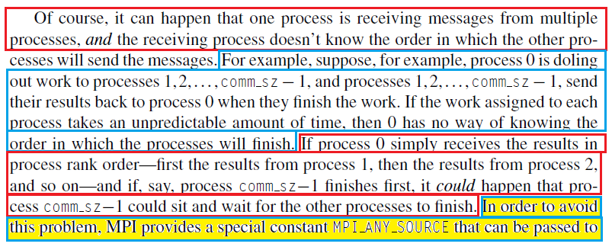
Message Matching (3.1.9)
From your textbook. Page 91
Copyright © 2010, Elsevier Inc. All rights Reserved

Slide 5
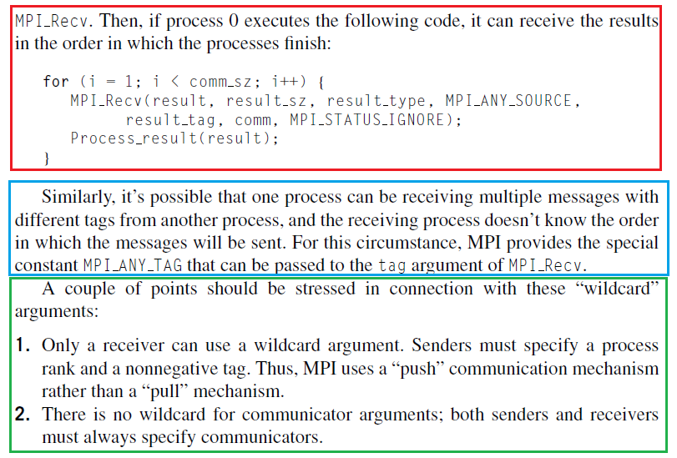
Message Matching (3.1.9)
From your textbook. Page 92
Copyright © 2010, Elsevier Inc. All rights Reserved

Slide 6

Receiving messages (3.1.10)
A receiver can get a message without knowing:
  the amount of data in the message,
  the sender of the message,
  or the tag of the message.
status structure that contains 3 important entities
        (source, tag, error code of the received messages)
Copyright © 2010, Elsevier Inc. All rights Reserved

Slide 7
status_p argument (3.1.10)
MPI_Status*
MPI_Status* status;
status.MPI_SOURCE
status.MPI_TAG
MPI_SOURCE
MPI_TAG
MPI_ERROR
Copyright © 2010, Elsevier Inc. All rights Reserved

Slide 8


How much data am I receiving? (3.1.10)
Copyright © 2010, Elsevier Inc. All rights Reserved

Slide 9

Issues with send and receive
Exact behavior is determined by the MPI implementation.
MPI_Send may behave differently with regard to buffer size, cutoffs and blocking.
MPI_Recv always blocks until a matching message is received.
Know your implementation;
don’t make assumptions!
Copyright © 2010, Elsevier Inc. All rights Reserved

Slide 10
MPI_Send
The sending process has two options
  Option # 1: Message is Buffered.
  Option # 2: it can Block.
  ========================================
Option #1:
  If it buffers the message, the MPI system will place the message (data and envelope) into its own internal storage, and the call to MPI_Send will return.
  When we use MPI_Send, and when the Fx returns, we DO NOT actually know whether the message has been transmitted. We only know that the storage we used for the message “the send buffer” is available for reuse by our program
Copyright © 2010, Elsevier Inc. All rights Reserved

Slide 11
MPI_Send
Option #2 (Blocking):
  It will wait until it can begin transmitting the message and the call to MPI_Send may not return immediately
For MPI_Send:
  The exact behavior or MPI_Send is determined by the MPI_Implementation, however, typical implementations have a “cutoff” message size.
    If (message size < cutoff)→ Buffered
    If (message size > cutoff) → Block
Copyright © 2010, Elsevier Inc. All rights Reserved

Slide 12
MPI_Recv
Major difference between MPI_Recv and MPI_Send:
MPI_RECV will ALWAYS BLOCK
MPI_Recv will always block until a matching message is received
Copyright © 2010, Elsevier Inc. All rights Reserved

Slide 13
MPI requires This
Message to be NON-overtaking
What does it mean?
1. (P1, (m1, m2), P2)
Regarding the sending:
m1 must be available to P2 before m2
Copyright © 2010, Elsevier Inc. All rights Reserved

Slide 14
MPI requires This
Now what about this:
((P1, m1), (P2, m2), P3)
There are NOT restrictions in the arrival of messages sent by different processes, this means, m2 can arrive first than m1 or vice versa
WHY ?
MPI CANNOT impose performance on a network
Copyright © 2010, Elsevier Inc. All rights Reserved

Slide 15
Students
Please read 3.1.12
Copyright © 2010, Elsevier Inc. All rights Reserved

Slide 16
Potential Pitfalls For MPI_Recv
If you are trying to receive and nobody is sending you a message, you will wait forever (hang)
  This is the case of a MPI_Recv without matching MPI_Send
Make sure that you use your tags correctly
Use rank wisely
  Rank 1 sends and Rank 1 receives (NO)
    Hanging (The receive will not match the send)
    Matching another send (worse)
Copyright © 2010, Elsevier Inc. All rights Reserved

Slide 17
Potential Pitfalls For MPI_Send
If a call to MPI_Send blocks, and there is not matching receive, then you will hang forever.
If the second case occurs (buffered) and MPI_Send returns, then the message that we were trying to send will be lost.
Copyright © 2010, Elsevier Inc. All rights Reserved

Slide 18
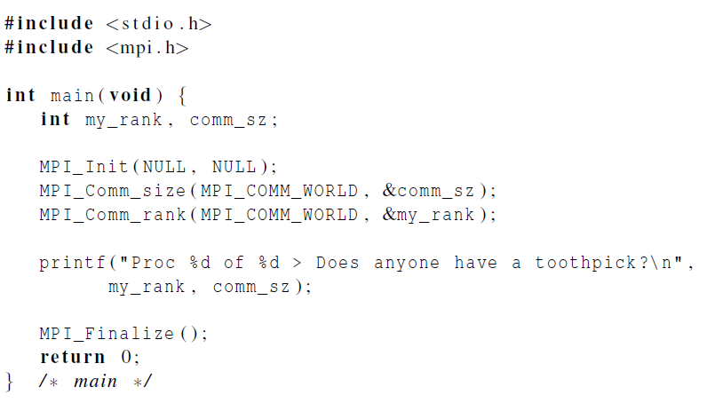
Dealing with I/O
Each process just
prints a message.
Copyright © 2010, Elsevier Inc. All rights Reserved

Slide 19
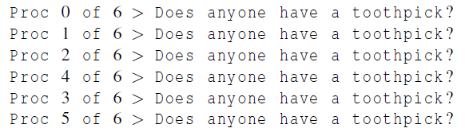

Running with 6 processes
unpredictable output
Copyright © 2010, Elsevier Inc. All rights Reserved

